Slide 1

REVENUE METRİCS ANALYSİS FOR MULTİ-PRODUCT GAMİNG PLATFORM

Slide 2
OBJECTIVE:
Review GoIT Game Department's 2022 revenue analysis and make proposals to optimize business operations and increase profitability.

Slide 3
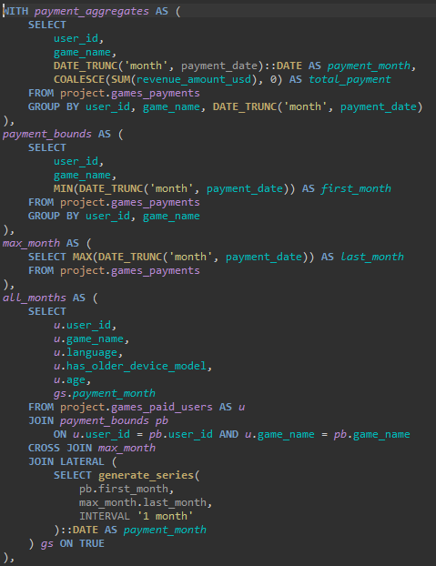
DATA SET:
games_paid_users.csv
games_payments.csv
TECHNOLOGY USED:
SQL - PostgreSQL

Slide 4
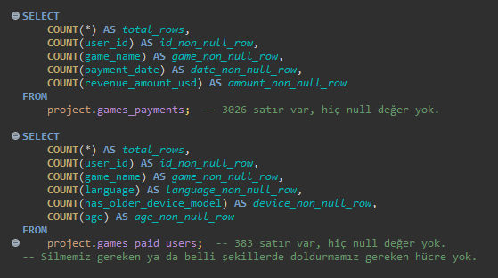
DATA SET ANALYSIS:
No empty, incorrect, or missing data was detected.
Data for March–December 2022 is available.
Game1 was released in October and is a very new game.
No data was found for Game2 in November.
The average user age is 23, with a standard deviation of 6.6.

Slide 5
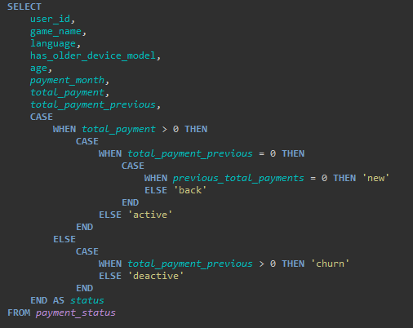
DATA SET MERGING:
Additions were made with feature engineering to simplify analysis.
Optimized code for performance improvement of the query,
The data set was made ready for revenue analysis and visualization.

Slide 6
METRICS USED:
Revenue, , Paid Users, ARPPU, MRR, New MRR, Contraction MRR, Expansion MRR, Churned Users, Churn Rate, Churned Revenue, LTV

Slide 7
INCOME ANALYSIS and VISUALIZATION:
TABLEAU

Slide 8
ASSESSMENT:
EXTERNAL FACTORS:
Russia's invasion of Ukraine - February 2022
Christmas Holidays and New Year
GAME PREFERENCE:
Removal of Game-2 from the application,
After analyzing Game-3's output data, Game-1's decision should be made.
MODES OF ACTION:
The target audience should be 15-25 years old,
Campaigns should be prepared for deactive users,
Advertising campaigns need to be updated to attract new users.

Slide 9
I HEREBY SUBMIT

